Slide 1
Readiness for school
The School Nurse team would like to offer you some ideas, information and ways to contact us, for us to support you and your children to achieve Physical and Emotional, health and well being during their time at school.

Slide 2
Contents
Immunisations
Toileting and Continence
Handwashing
Healthy Eating
Speech and Language
Headlice
Dental Hygiene
NCMP, Vision and Hearing Screening (child health programme)

Slide 3
Check your child’s immunisations are up to date

Slide 4
Immunisations what and when
1 year | Hib/MenC (1st dose) MMR (1st dose) Pneumococcal (PCV) vaccine (2nd dose) MenB (3rd dose)
2 to 10 years | Flu vaccine (every year)
3 years and 4 months | MMR (2nd dose) 4-in-1 pre-school booster

Slide 5
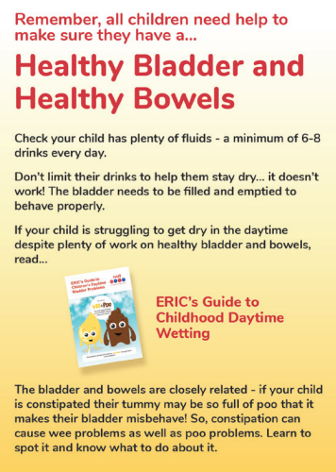
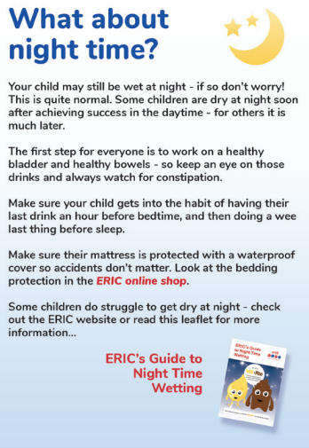

Slide 6
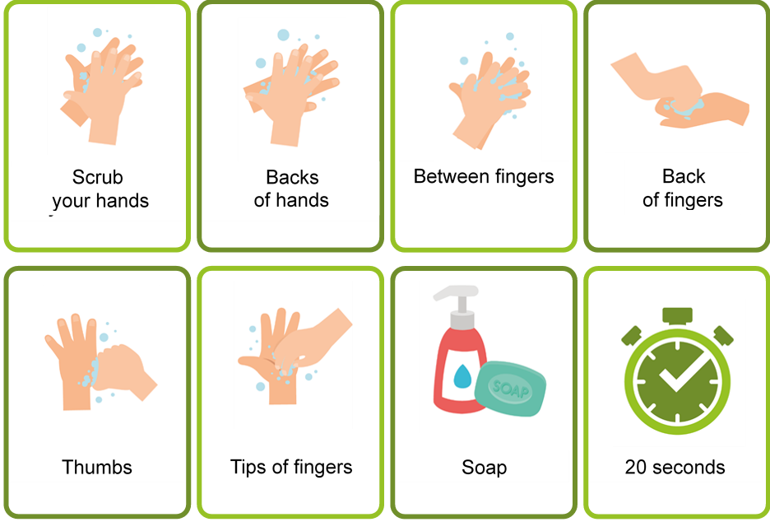
Handwashing

Slide 7
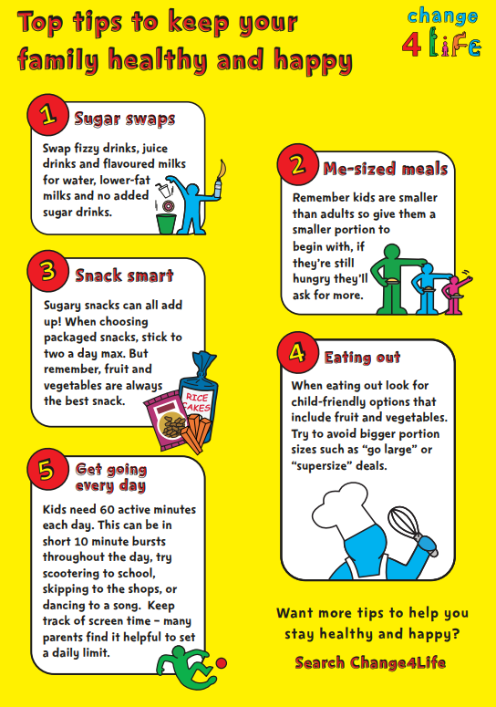
https://www.nhs.uk/healthier-families/

Slide 10
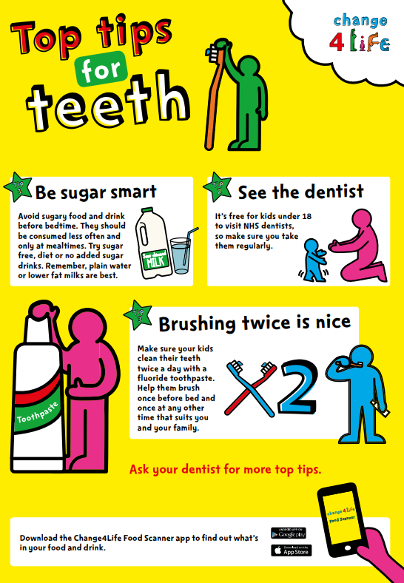

Slide 11
Child Health Programme
Soon after your child starts in Reception you will be sent a digital Child Health Programme Booklet. It’s sent via email from your child’s school and contains loads of really helpful information to help you support your child to have a healthy journey through school.
It includes information on:
School Nursing and how to get advice or an appointment
Vision Screening
Hearing screening
Height and weight measurement- NCMP (National Child Measurement Programme)
Healthy Eating advice
Keeping your child well in school ( including immunisations, Flu vaccine and the importance of hand hygiene)
Common childhood illnesses
Dental hygiene and toothbrushing (NHS Dental waiting list contact 0333 006 3300, or email accessdentalhelpline@nhs.net)
Parent and carer wellbeing workshops
Sun safety
And much, much more.

Slide 12
You can use the Child Health Checklist to assist you to Identify areas where you may need advice or support from the School Nursing Team. - Complete the Checklist - Identify areas you may need support - Contact School Nursing Team with your details -Email: coco.childrenscmc@nhs.net. The School Nursing team will then be in contact to arrange an appointment for a full Health Assessment. we offer a comprehensive Health Assessment.

Slide 13
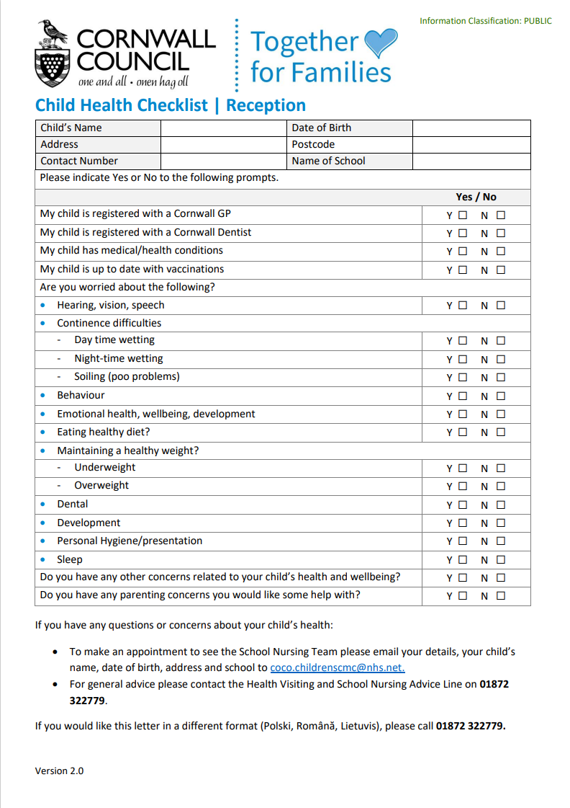
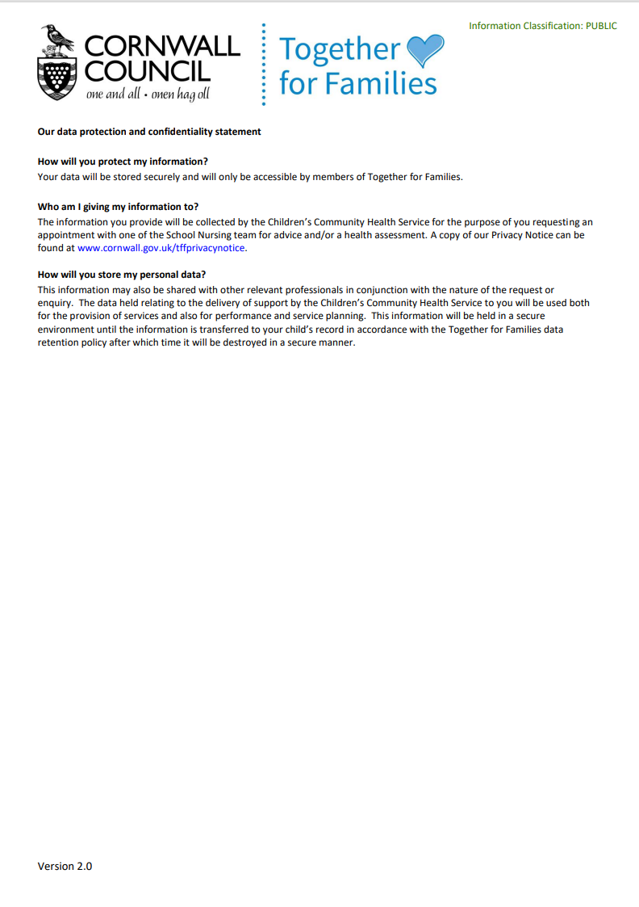
School Health Assessments - Cornwall Council

Slide 14
If you have any health concerns about your child you can contact us via the Health Visitor and School Nurse advice line or the Early Help Hub Health Visitor and School Nurse Advice Line Tel: 01872 322779 Monday to Friday 9am-5pm. If the line is busy you will be able to leave a message and you will receive a call back. Email: hvsnadvice@cornwall.gov.uk https://www.cornwall.gov.uk/schoolnursing Early Help Hub Tel: 01872 322277 Monday – Thursday 8:45am – 5:15pm Friday 8:45am – 4:45pm Closed on Bank Holidays. Email: earlyhelphub@cornwall.gov.uk

